Slide 1
MILESTONE 2 —
Cognitive Challenge & Wake-Up Intelligence

Slide 2
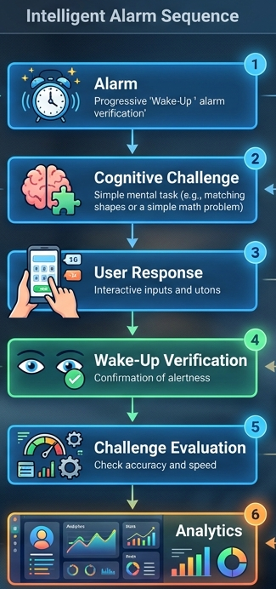
Objective:
Transform a basic alarm into an interactive wake-up experience
Introduce cognitive challenges during wake-up
Verify user responsiveness
Evaluate challenge performance
Generate challenge-related analytics

Slide 3
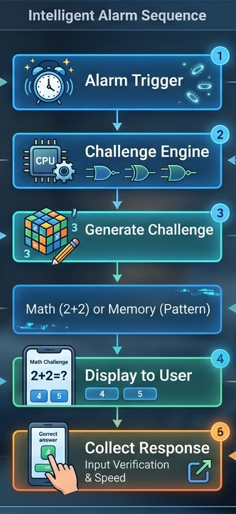
Cognitive Challenge Engine
Key Functions:
Initiates a challenge when the alarm is triggered
Selects/generates an appropriate cognitive challenge
Presents the challenge to the user
Collects the user's response
Passes the response for evaluation

Slide 4
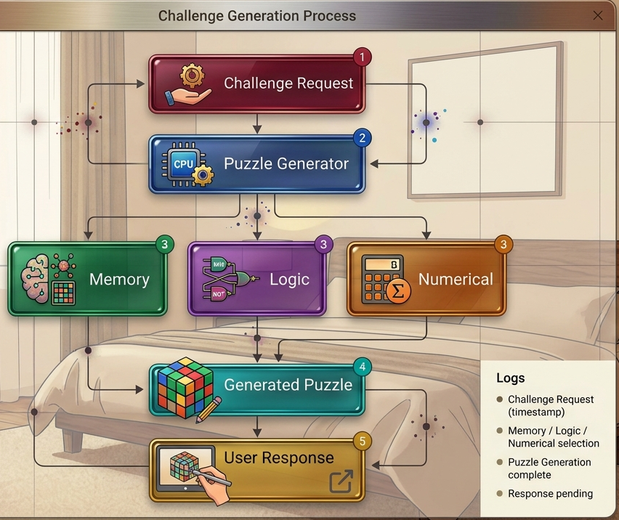
Dynamic Puzzle Generation
Purpose:
Generate cognitive puzzles
Provide an active wake-up interaction
Support different challenge formats

Slide 5
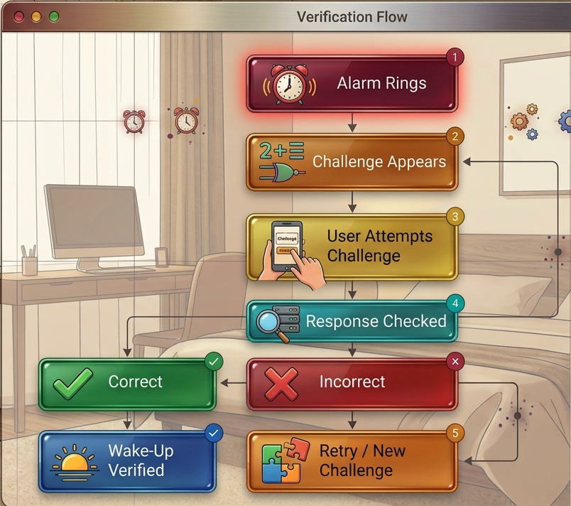
Wake-Up Verification Mechanism:
Verifies user responsiveness
Requires active user interaction
Validates the challenge response
Confirms the user is fully awake
Allows retry on incorrect response

Slide 6
Challenge Evaluation System
The system evaluates the user's challenge attempt based on:
Response correctness
Challenge completion
Number of attempts
Response performance
Evaluation Flow:
User Response
↓
Answer Validation
↓
Performance Evaluation
↓
Challenge Result

Slide 7
Challenge Performance Analytics
Analytics generated from challenge interactions:
Challenge completion results
Response performance
Attempt information
User challenge patterns
Outcome:
The alarm system now provides an interactive and verifiable cognitive wake-up experience instead of a basic alarm notification.

Slide 8
THANK YOU

